Slide 3
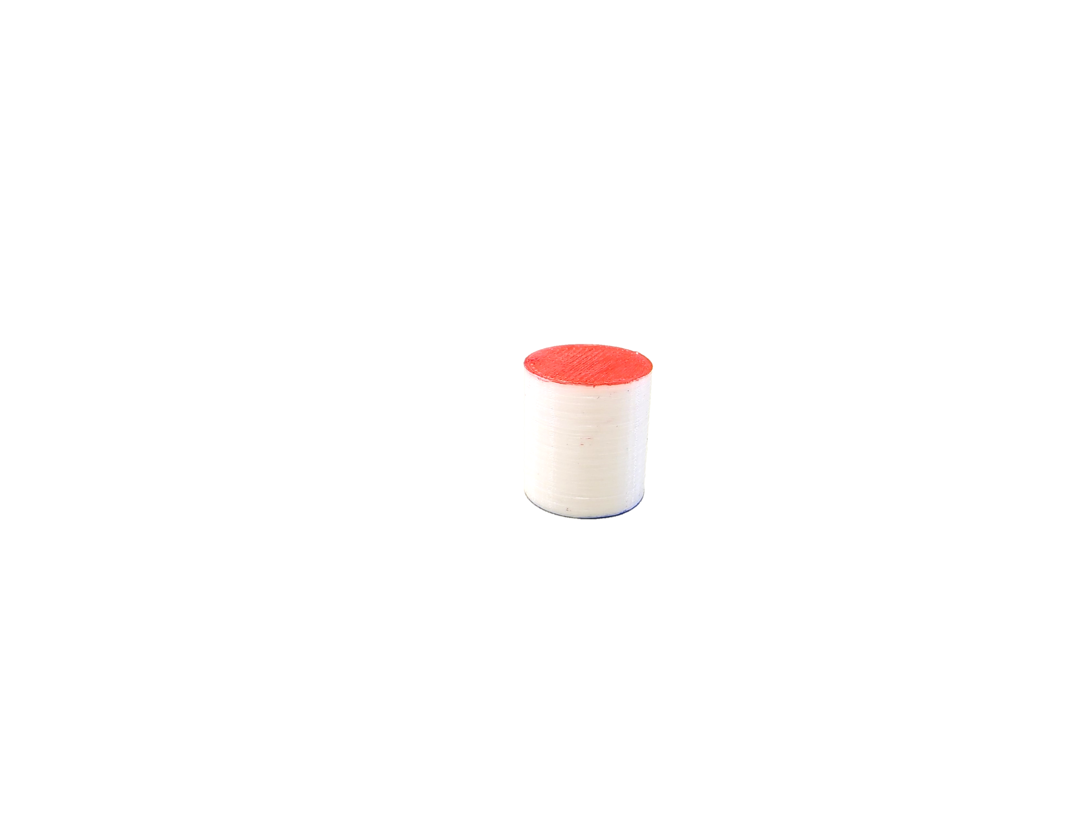
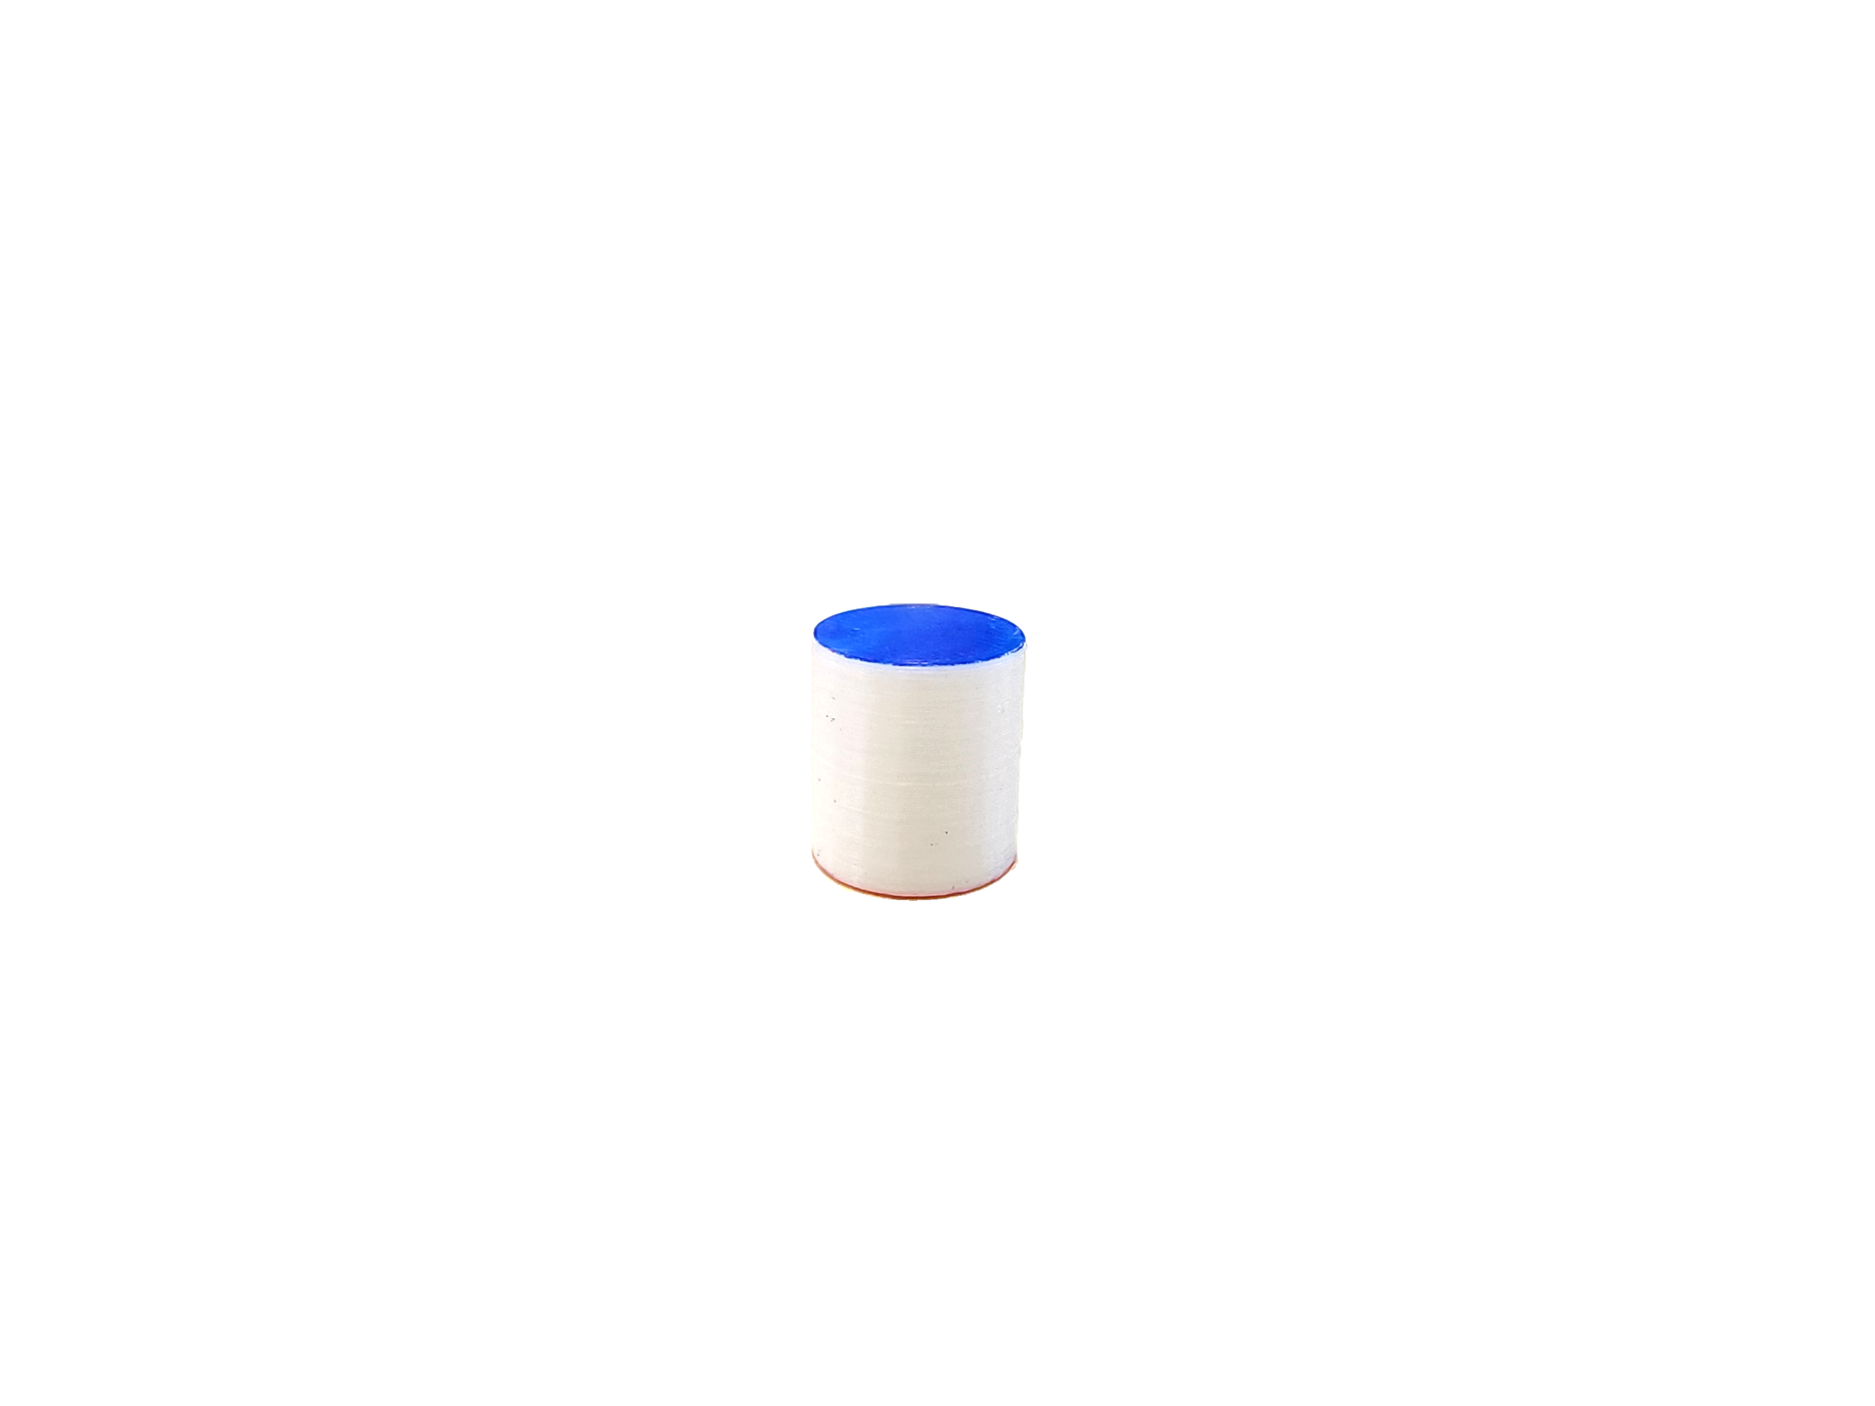
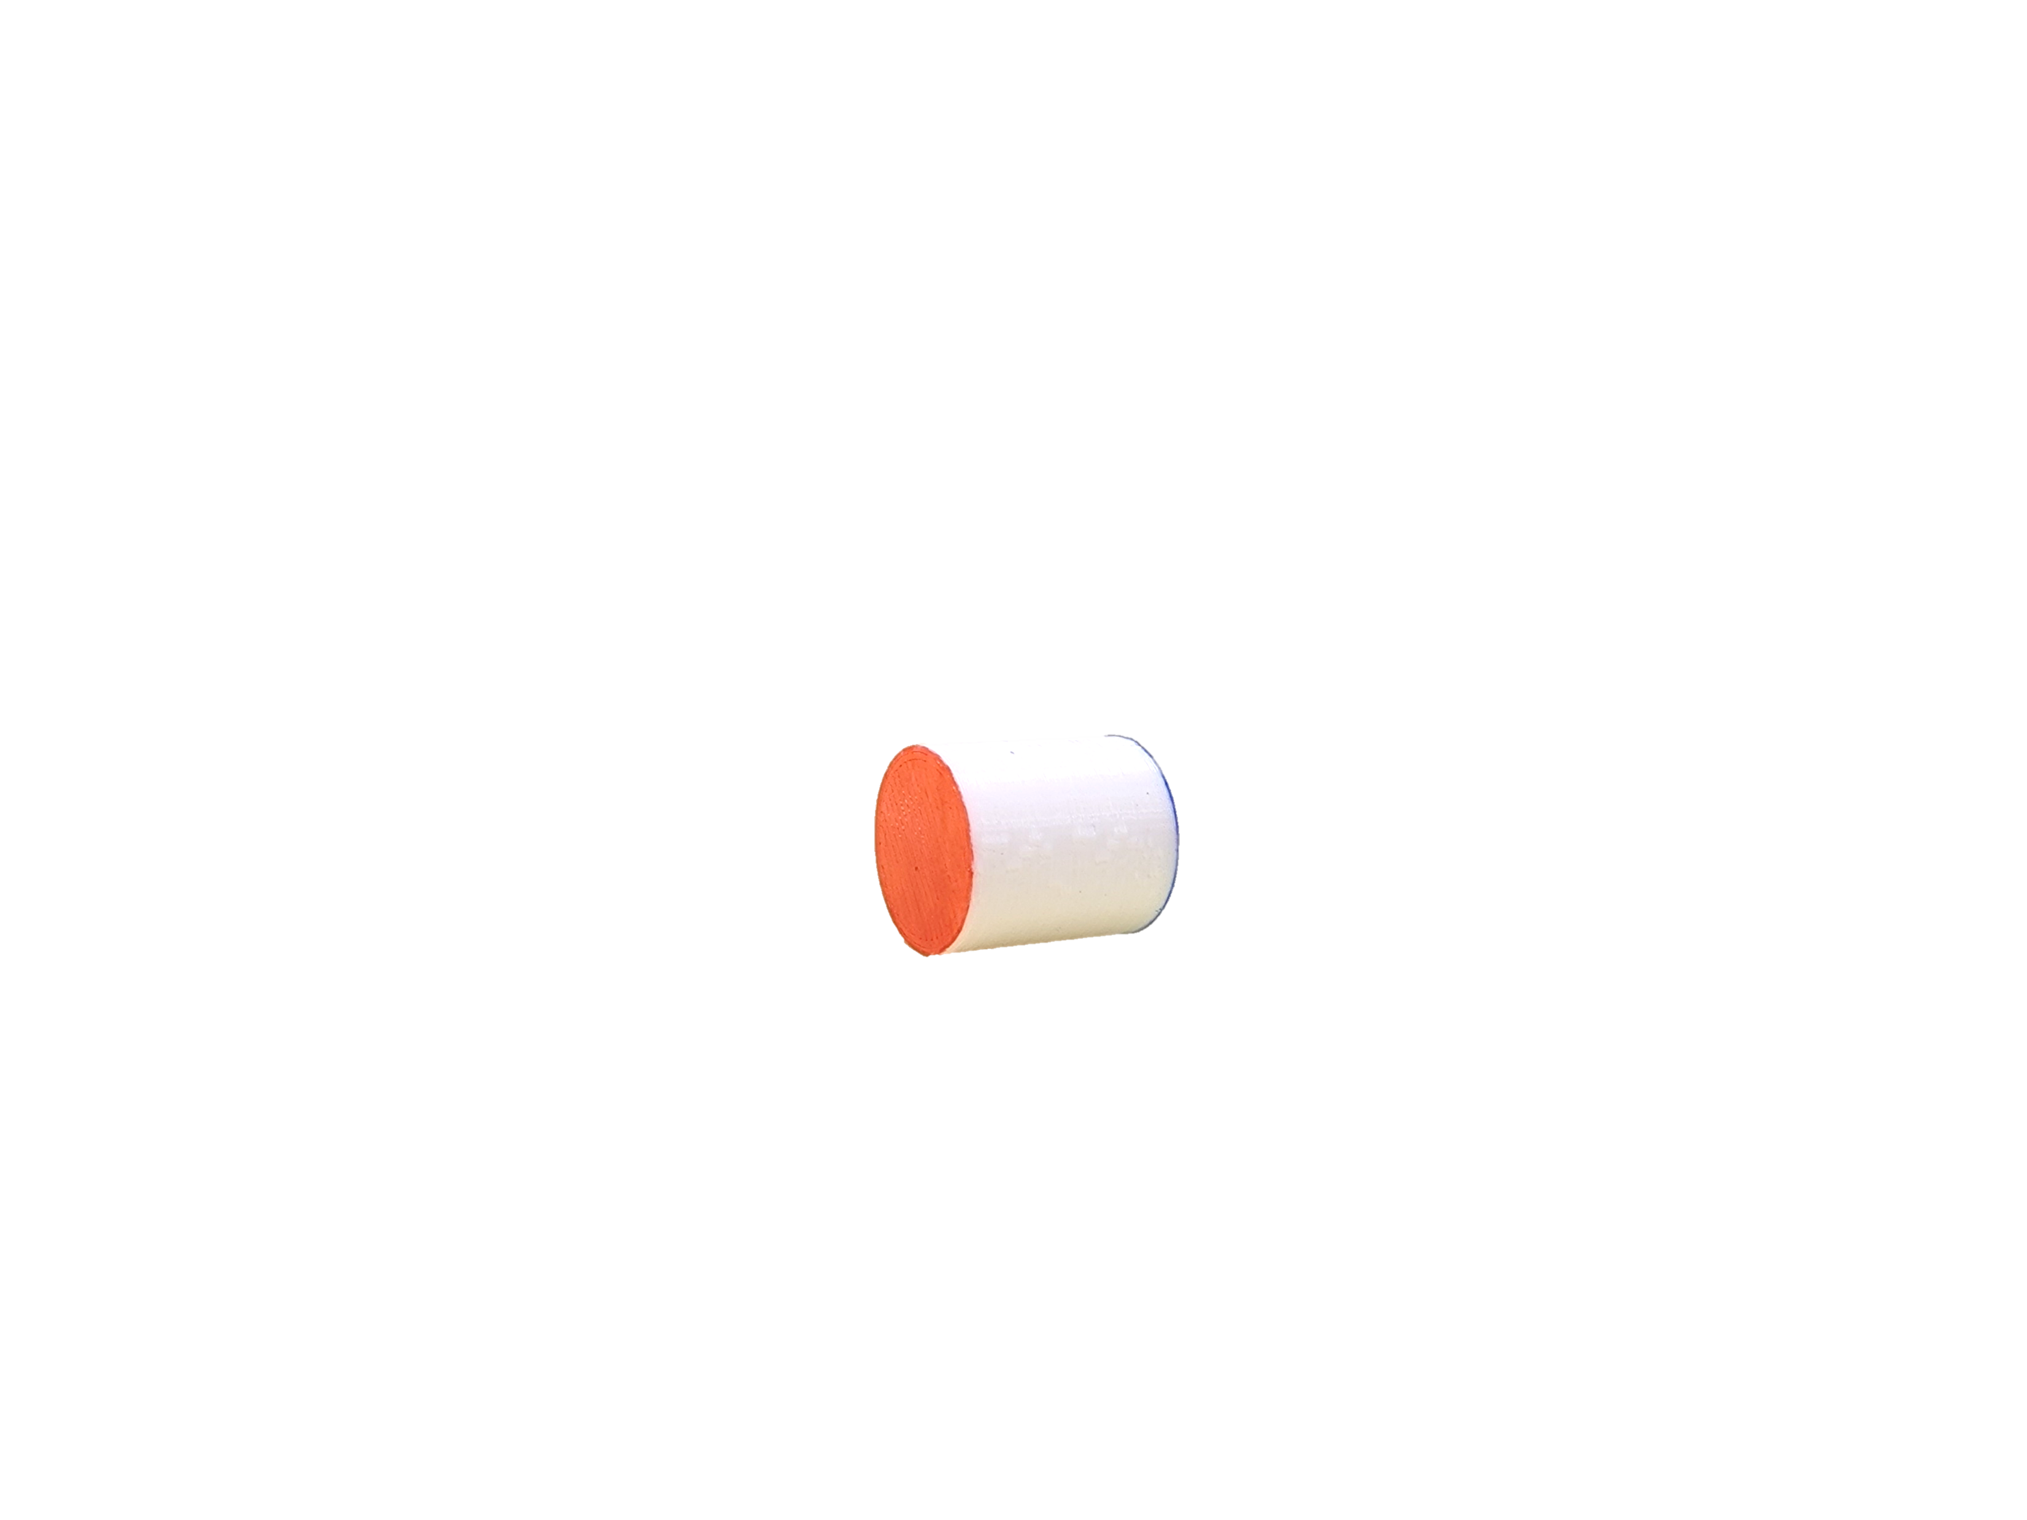
The phenomenon
$$\frac{1}{3}$$
$$\frac{1}{3}$$
“side”
$$\frac{1}{3}$$
“face”
$$\frac{2}{3}$$
Friction
Restitution
Air resistance
Mass distribution
Way of throwing the dice
Height of the throw
Possible influences
Notes:
Nos cilindros, temos 3 estados: o primeiro, caindo em uma das faces circulares, o segundo na outra face. Esses dois estados nós agrupamos em um macroestado e chamamos de “face”. O terceiro estado é caindo na lateral e chamados de “lado”.
Na condição de um dado justo, “face” deve ter probabilidade de 2/3 e lado de 1/3.
Para determinar as probabilidades de cada estado para qualquer cilindro, jogamos aleatoriamente vários cilindros, mas os resultados foram inconsistentes entre os cilindros idênticos. Assim concluímos que diversos fatores poderiam influenciar no resultado, que se resumem principalmente no material do cilindro e da superfície e nas condições de lançamento.

Slide 4
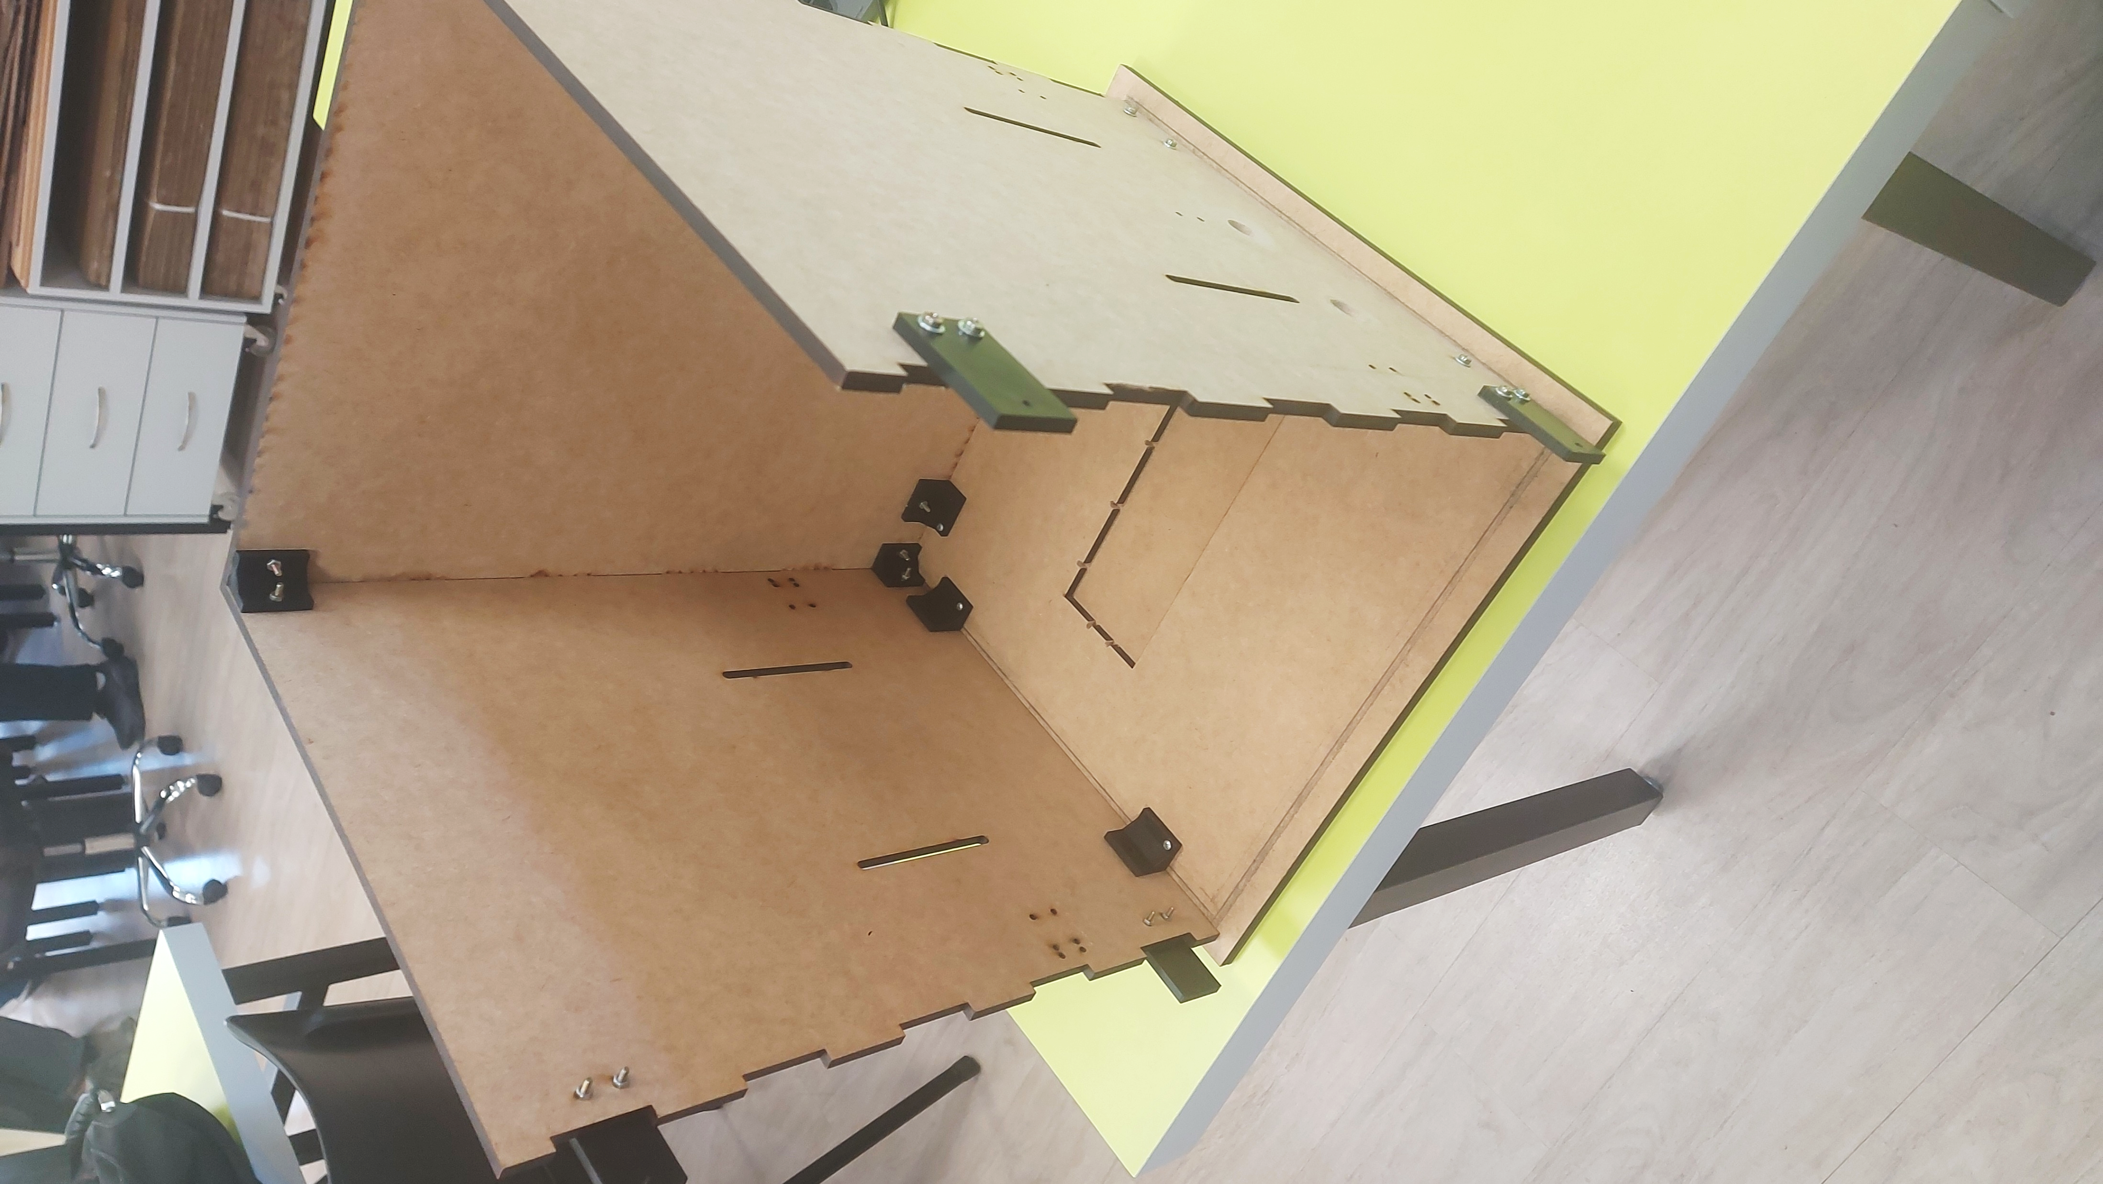
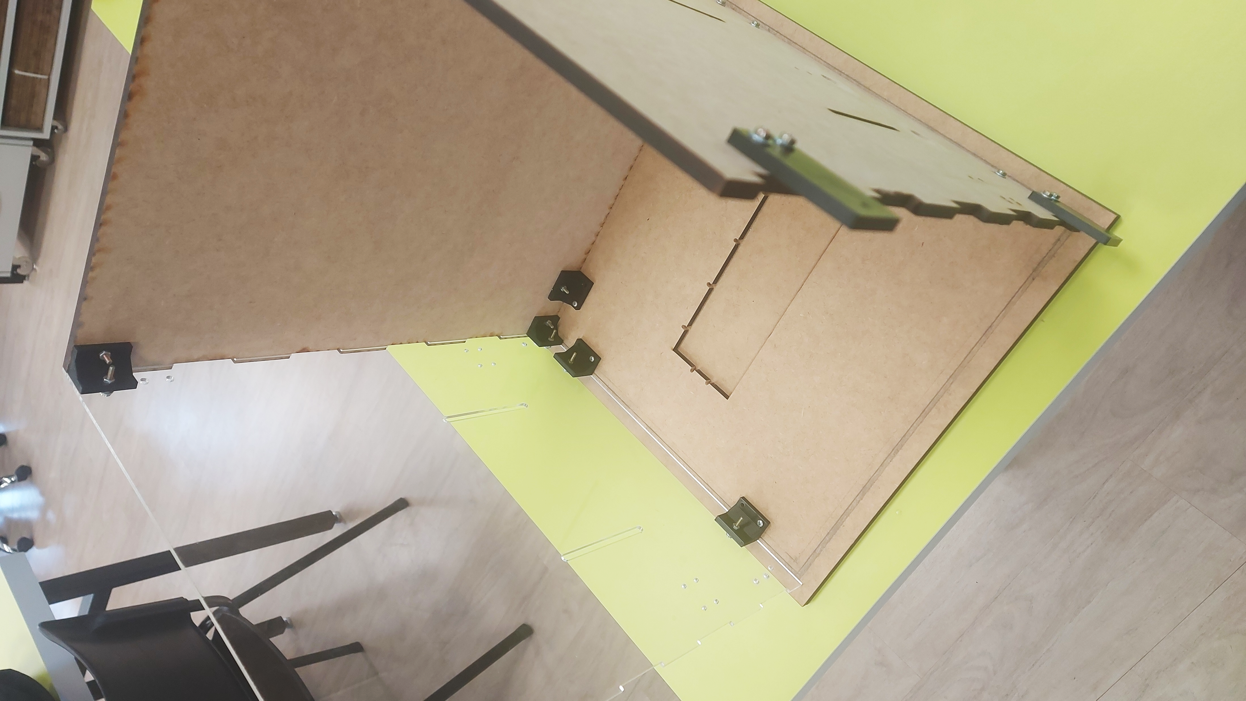
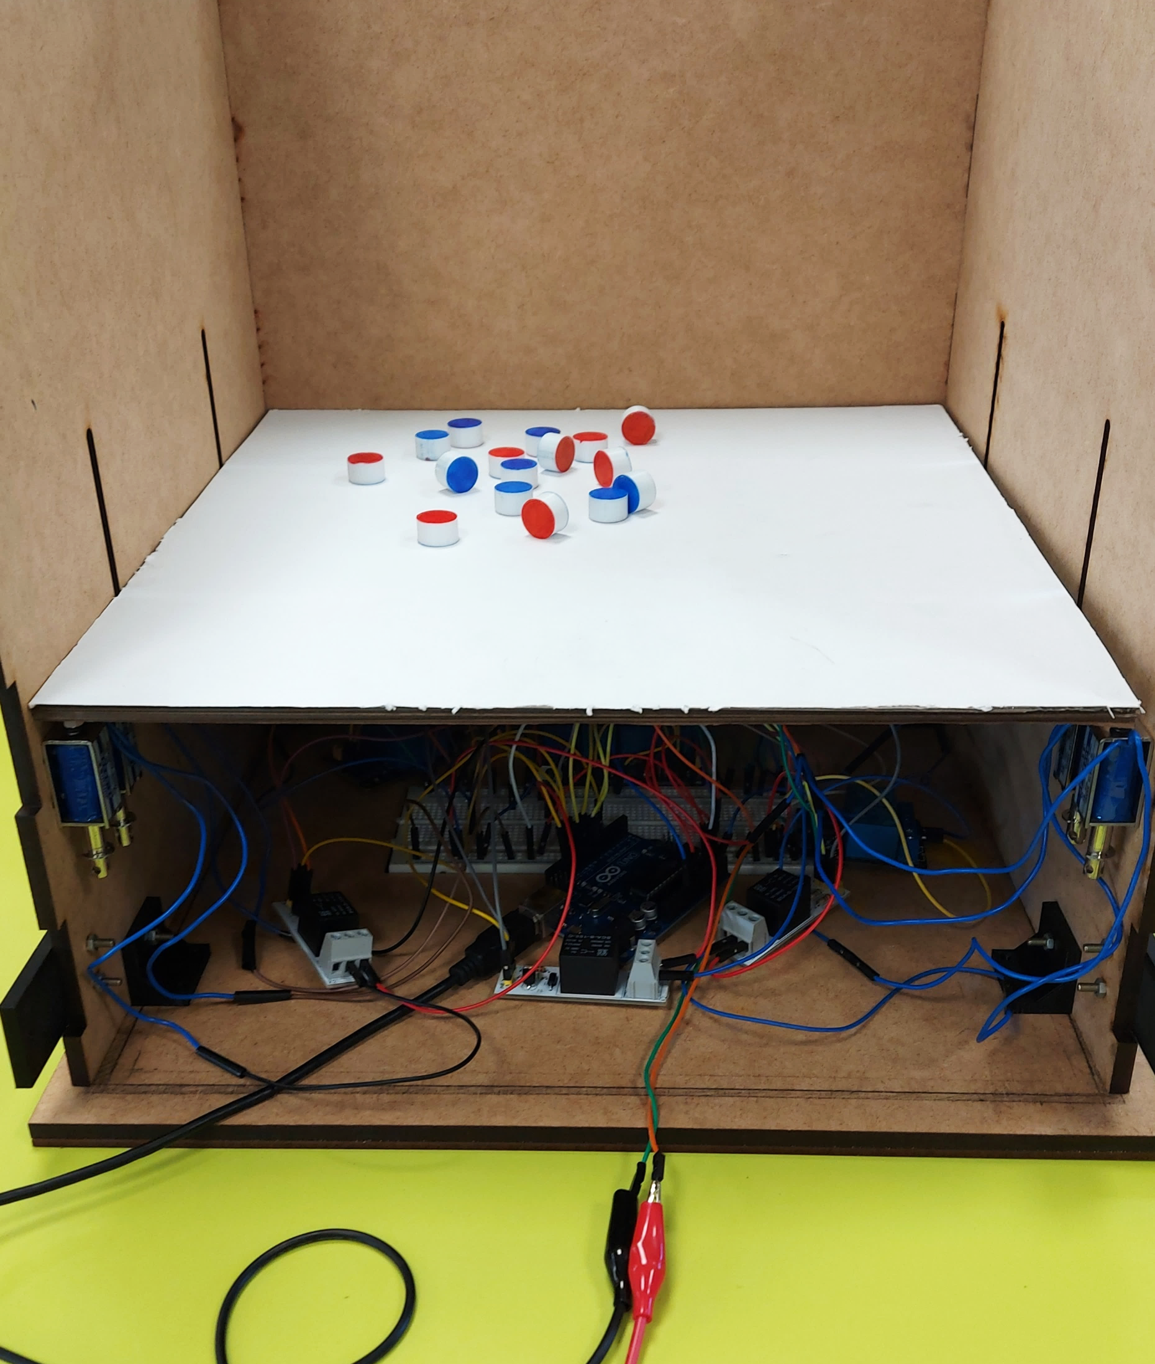
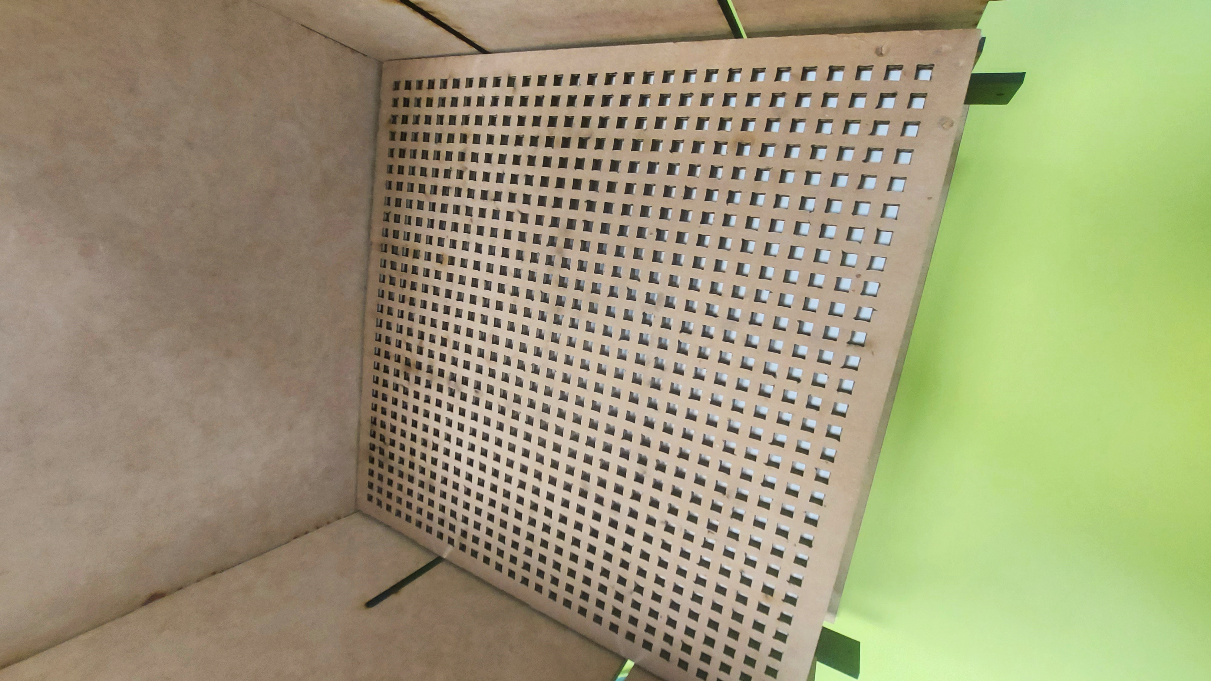
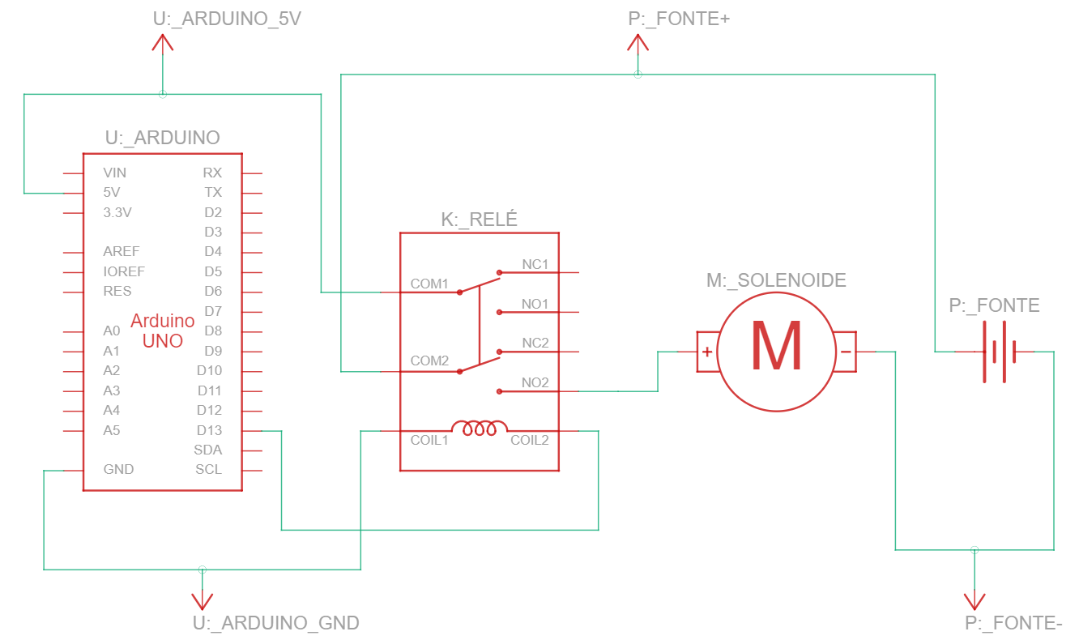
The machine
Notes:
Com essas inconsistências, criamos uma máquina para padronizar os lançamentos. 8 solenoides atingem uma placa de papelão e levantam os cilindros, fazendo um lançamento. Quando os cilindros se estabilizam um programa em python tira a foto das posições finais e reconhece o estado de cada cilindro.
Para tentar reduzir essas inconsistências, criamos uma máquina, melhorando o controle das condições e permitindo que aumentássemos muito a quantidade de lançamentos. Essa máquina consiste em uma caixa na qual solenoides atingem a superfície onde estão os cilindros, fazendo um lançamento. Depois do lançamento, uma câmera posicionada em cima da caixa tira uma foto dos cilindros e um programa computacional reconhece as posições dos dados.

Slide 5
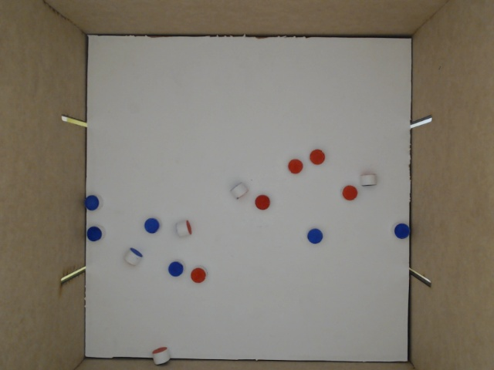
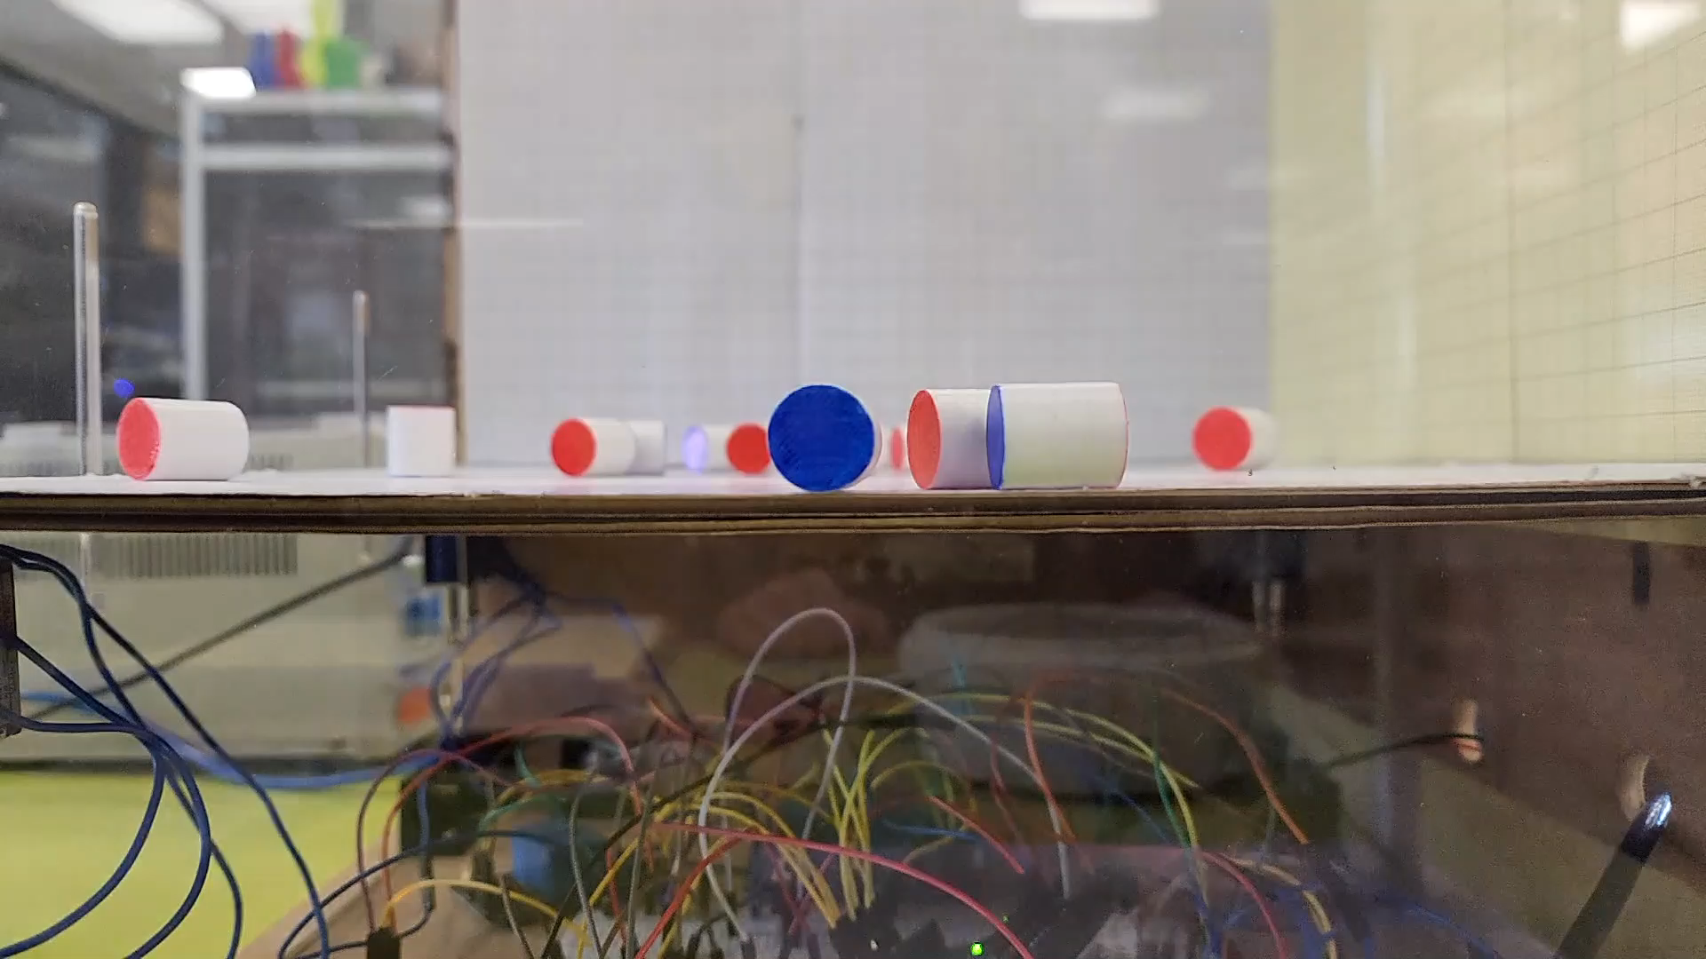
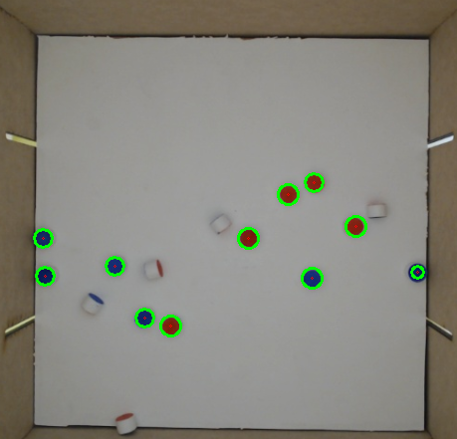
The machine
Videozinho
Notes:
Aqui temos um vídeo do lançamento do cilindro pela máquina e duas fotos, uma antes e outra depois do lançamento.

Slide 7
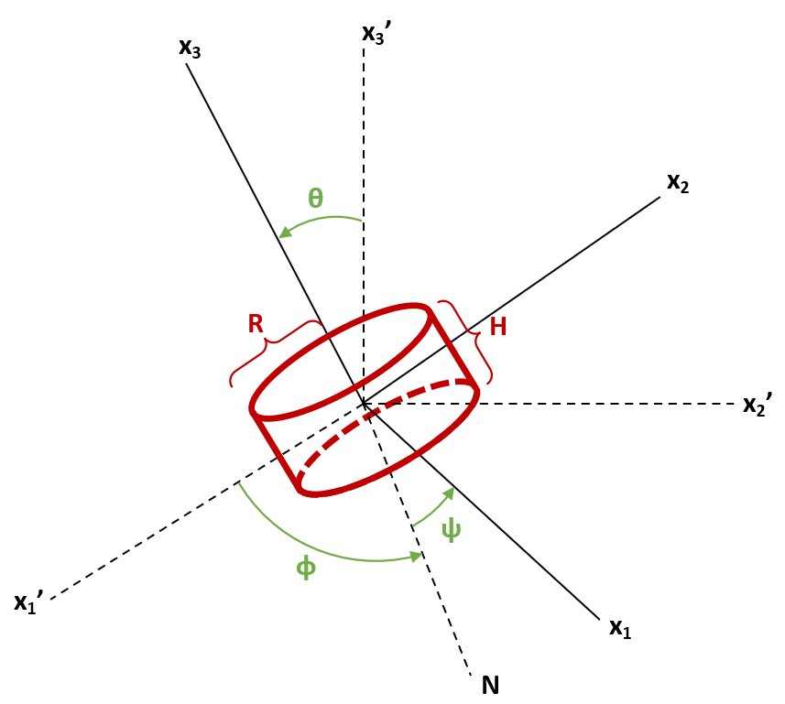
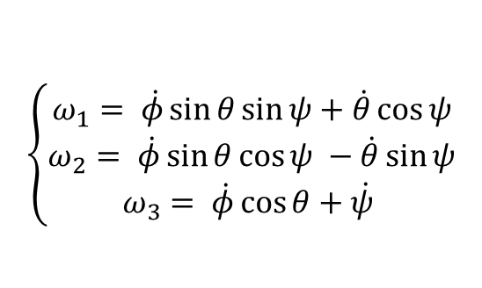
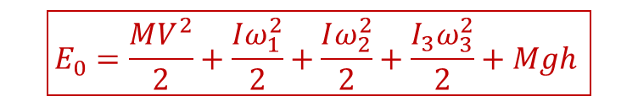
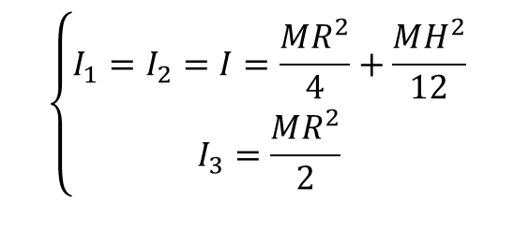
Movement of a cylinder in free fall
$$\left\{\begin{aligned}ω_{1}= \dot{φ}\sin{θ\sin{ψ}+\dot{θ}\cos{ψ}} \\ ω_{2}= \dot{φ}\sin{θ}\cos{ψ} −\dot{θ}\sin{ψ} \\ ω_{3}= \dot{φ}\cos{θ}+\dot{ψ} \end{aligned}\right.$$
Angular velocities
$$\left\{\begin{aligned}I_{1}=I_{2}=I=\frac{MR^{2}}{4}+\frac{MH^{2}}{12} \\ I_{3}=\frac{MR^{2}}{2}\end{aligned}\right.$$
Moments of inertia
$$\boxed{E_{0}=\frac{MV^{2}}{2}+\frac{Iω_{1}^{2}}{2}+\frac{Iω_{2}^{2}}{2}+\frac{I_{3}ω_{3}^{2}}{2}+Mgh }$$
Mechanical energy

Slide 8
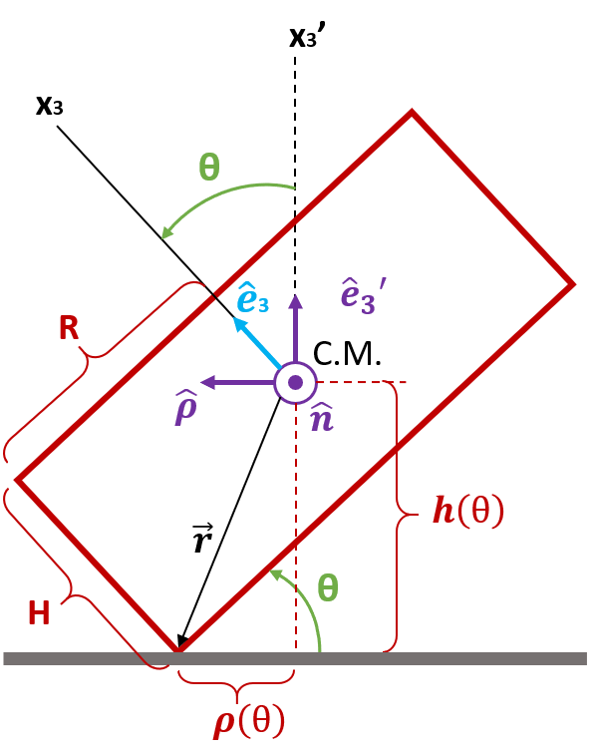
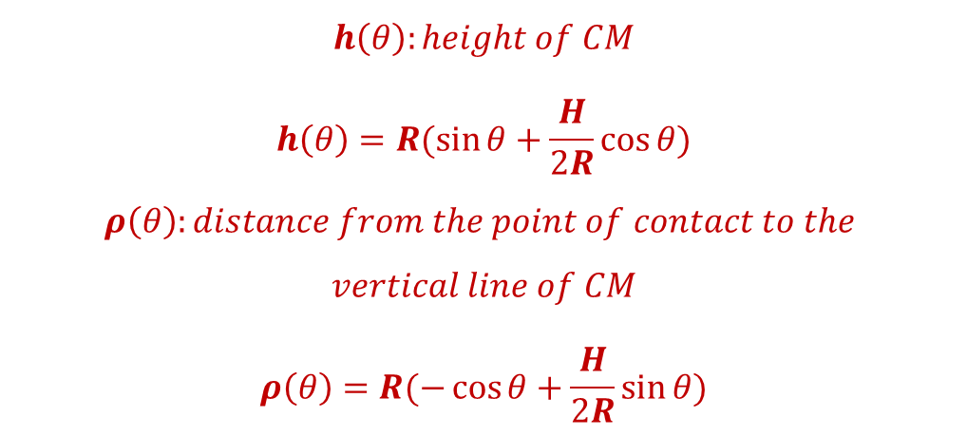
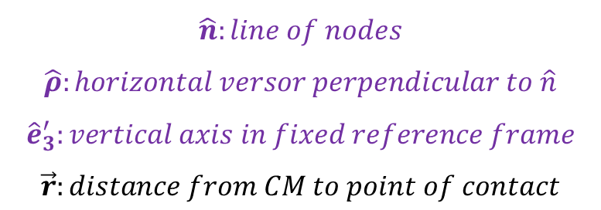
Cylinder collision dynamics
Axes and dimensions
$$h\left(θ\right):height of CM$$
$$h\left(θ\right)=R(\sin{θ}+\frac{H}{2R}\cos{θ})$$
$$ρ\left(θ\right):distance from the point of contact to the$$
$$vertical line of CM$$
$$ρ\left(θ\right)=R(−\cos{θ}+\frac{H}{2R}\sin{θ})$$
$$\hat{n}:line of nodes$$
$$\hat{ρ}:horizontal versor perpendicular to \hat{n}$$
$${\hat{e}}_{3}^{′}:vertical axis in fixed reference frame$$
$$\vec{r}:distance from CM to point of contact$$

Slide 9
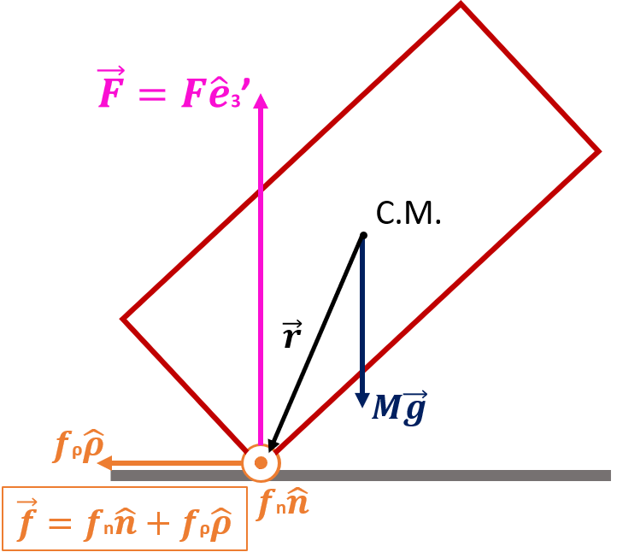
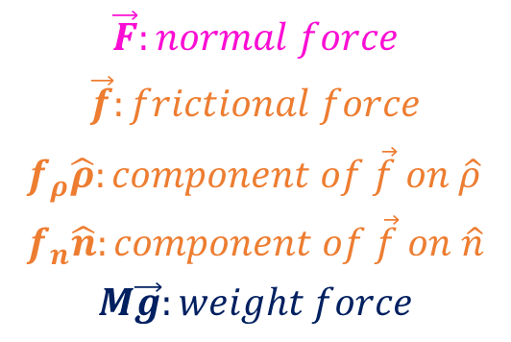
Cylinder collision dynamics
Acting forces
$$\vec{F}:normal force$$
$$\vec{f}:frictional force$$
$$f_{ρ}\hat{ρ}:component of \vec{f} on \hat{ρ} \\ f_{n}\hat{n}:component of \vec{f} on \hat{n}$$
$$M\vec{g}:weight force$$

Slide 10
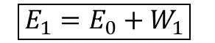
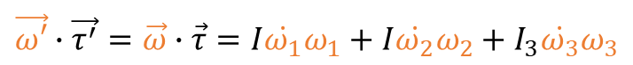
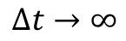
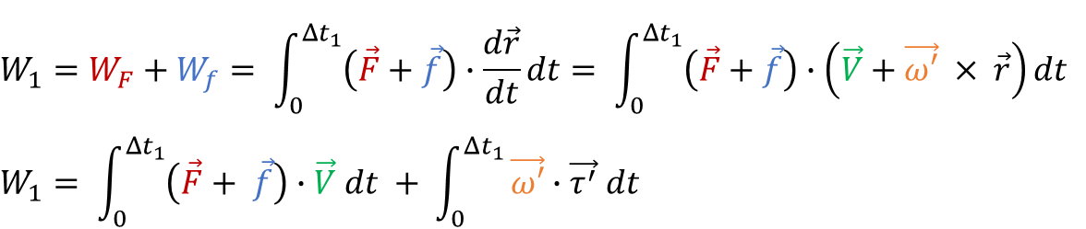

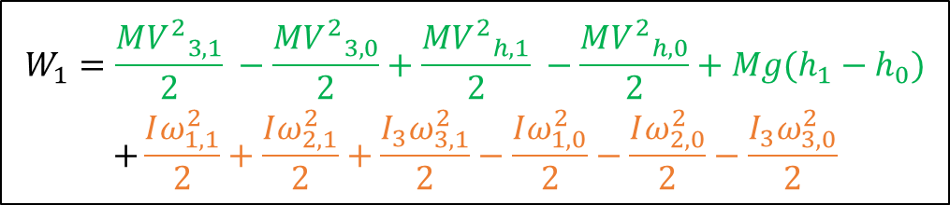
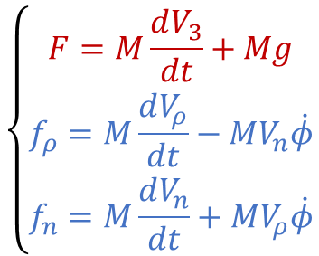
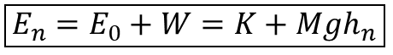
Cylinder collision dynamics: Dissipated energy
First collision
$$W_{1}=W_{F}+W_{f}= \int_{0}^{Δt_{1}}{\left(\vec{F}+\vec{f}\right)∙\frac{d\vec{r}}{dt}dt}= \int_{0}^{Δt_{1}}{\left(\vec{F}+\vec{f}\right)∙\left(\vec{V}+\vec{ω′} × \vec{r}\right)dt}$$
$$W_{1}= \int_{0}^{Δt_{1}}{\left(\vec{F}+ \vec{f}\right)∙\vec{V} dt} + \int_{0}^{Δt_{1}}{\vec{ω′}∙\vec{τ^{′}} dt}$$
$$\begin{aligned}W_{1}=\frac{M{V^{2}}_{3,1}}{2} −\frac{{{MV}^{2}}_{3,0}}{2}+\frac{M{V^{2}}_{h,1}}{2} −\frac{M{V^{2}}_{h,0}}{2}+Mg(h_{1}−h_{0}) \\ +\frac{Iω_{1,1}^{2}}{2}+\frac{Iω_{2,1}^{2}}{2}+\frac{I_{3}ω_{3,1}^{2}}{2}−\frac{Iω_{1,0}^{2}}{2}−\frac{Iω_{2,0}^{2}}{2}−\frac{I_{3}ω_{3,0}^{2}}{2}\end{aligned}$$
(2) Rotational symmetry + Euler’s Equations
(1) Newton’s Second Law
$$\vec{ω′}∙\vec{τ^{′}}=\vec{ω}∙\vec{τ}=I\dot{ω_{1}}ω_{1}+I\dot{ω_{2}}ω_{2}+I_{3}\dot{ω_{3}}ω_{3}$$
$$\left\{\begin{aligned}F=M\frac{dV_{3}}{dt}+Mg \\ f_{ρ}=M\frac{dV_{ρ}}{dt}−MV_{n}\dot{φ} \\ f_{n}=M\frac{dV_{n}}{dt}+MV_{ρ}\dot{φ}\end{aligned}\right.$$
$$\boxed{E_{1}=E_{0}+W_{1}}$$
n collisions
$${W= W}_{1}+W_{2}+W_{3}+…+W_{n}$$
$$\boxed{E_{n}=E_{0}+W=K+Mgh_{n}}$$
$$Δt→∞$$
dissipation
$$\boxed{E=Mgh_{n}}$$

Slide 11
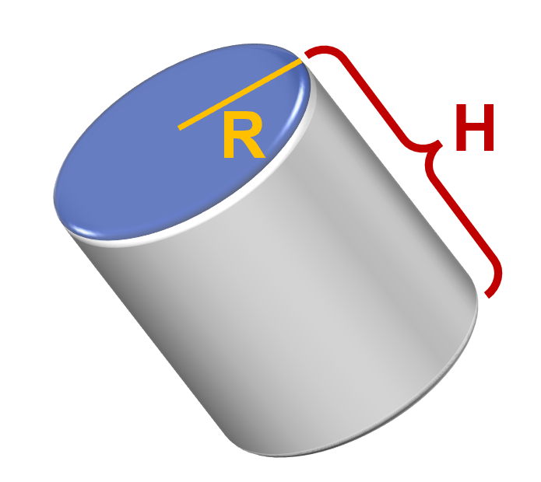
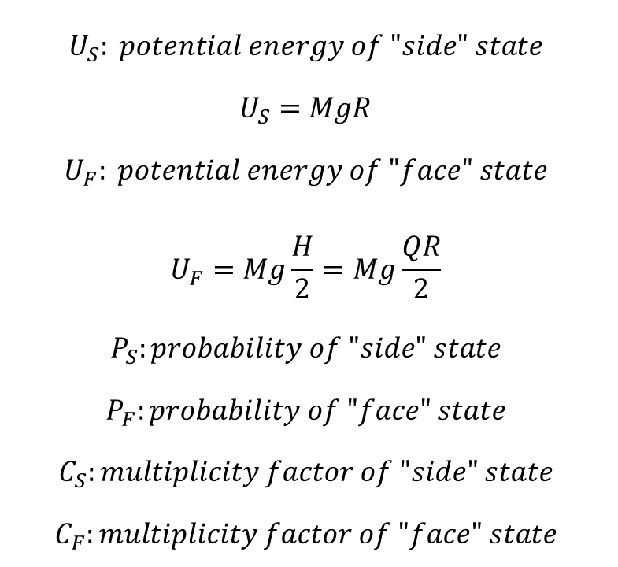

Definitions
$$U_{S}: potential energy of "side" state$$
$$U_{S}=MgR$$
$$U_{F}: potential energy of "face" state$$
$$U_{F}=Mg\frac{H}{2}=Mg\frac{QR}{2}$$
$$P_{S}:probability of "side" state$$
$$P_{F}:probability of "face" state$$
$$C_{S}:multiplicity factor of "side" state$$
$$C_{F}:multiplicity factor of "face" state$$
H
$$Q= \frac{H}{R}$$
R

Slide 12
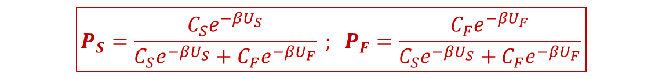
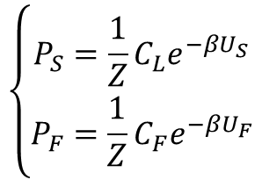
Canonical ensemble for a two-level system
$$\left\{\begin{aligned}P_{S}=\frac{1}{Z}C_{L}e^{−βU_{S}} \\ P_{F}=\frac{1}{Z}C_{F}e^{−βU_{F}}\end{aligned}\right.$$
Boltzmann Distribution
Normalization of probabilities
$$P_{S}+P_{F}=1⇒Z=C_{S}e^{−βU_{S}}+C_{F}e^{−βU_{F}}$$
$$\boxed{P_{S}=\frac{C_{S}e^{−βU_{S}}}{C_{S}e^{−βU_{S}}+C_{F}e^{−βU_{F}}} ; P_{F}=\frac{C_{F}e^{−βU_{F}}}{C_{S}e^{−βU_{S}}+C_{F}e^{−βU_{F}}}}$$
Notes:
Meta: determinar a probabilidade de cada estado ($P_{L} {\text{e} P}_{F}$)
Apêndice 1

Slide 13


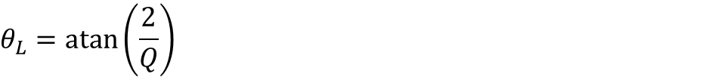

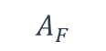
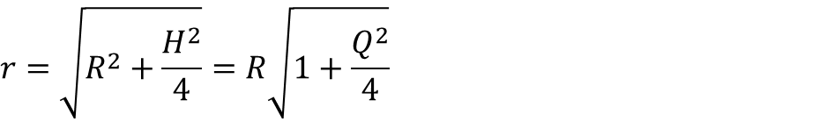

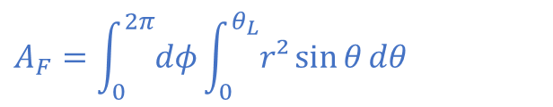

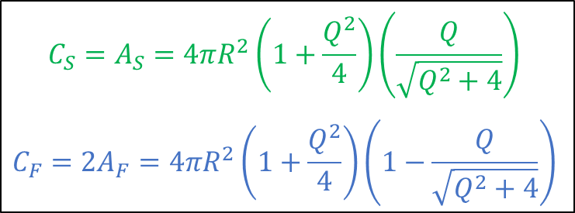


Multiplicity Factors
$$r=\sqrt{R^{2}+\frac{H^{2}}{4}}=R\sqrt{1+\frac{Q^{2}}{4}}$$
Circumscribed sphere
$$z$$
$$θ_{L}=\operatorname{atan}\left(\frac{2}{Q}\right)$$
$$A_{F}$$
$$A_{F}=\int_{0}^{2π}{dφ}\int_{0}^{θ_{L}}{r²\sin{θ}dθ}$$
$$R$$
$$\frac{H}{2}$$
$$θ_{L}$$
$$A_{S}=4πr^{2}−2A_{F}$$
$$\sqrt{R^{2}+\frac{H^{2}}{4}}$$
$$A_{L}$$
$$C_{S}=A_{S}=4πR^{2}\left(1+\frac{Q^{2}}{4}\right)\left(\frac{Q}{\sqrt{Q^{2}+4}}\right)$$
$$C_{F}=2A_{F}=4πR^{2}\left(1+\frac{Q^{2}}{4}\right)\left(1−\frac{Q}{\sqrt{Q^{2}+4}}\right)$$
$$A_{F}$$

Slide 14
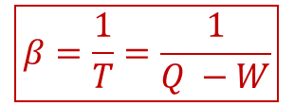
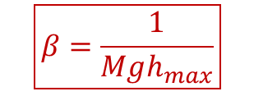
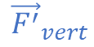
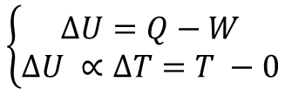
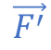

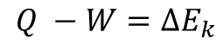

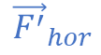
Estimating β
First Law of Thermodynamics
$$\left\{\begin{aligned}ΔU=Q−W \\ ΔU ∝ΔT=T −0\end{aligned}\right.$$
$$\vec{F^{′}}$$
$$\boxed{β=\frac{1}{T}=\frac{1}{Q −W}}$$
Similarly:
$$Q= Energy provided by the machine$$
$${\vec{F}}_{vert}$$
$$W=Enery lost in the first collision$$
$${\vec{F^{′}}}_{hor}$$
$$Q −W=ΔE_{k}$$
$${\vec{F}}_{hor}$$
Energy Conservation
$$ΔE_{k}=Mgh_{max}+Kinect Energy ≈Mgh_{max}$$
$${\vec{F^{′}}}_{vert}$$
$$\boxed{β=\frac{1}{Mgh_{max}}}$$

Slide 15

Horizontal throw
New estimative of $β$
$$β=\frac{1}{T}=\frac{1}{\int_{0}^{h}{{\vec{F}}_{vert}∙d\vec{r}}+\int_{0}^{ΔS_{hor}}{{\vec{F}}_{hor}∙d\vec{r}+W_{1}}}$$
At the throw
Upon entering in contact with the “thermal reservoir” (collision with the ground)
$$W_{1}=\int_{0}^{Δt_{1}}{\left(\vec{F}+\vec{f}\right)∙\left(\vec{V}+\vec{ω′} × \vec{r}\right)dt}$$
Increases, in magnitude, with collisons aproaching 90°
Padronized horizontal velocity
$$β=\frac{1}{T}=\frac{1}{\int_{0}^{h}{{\vec{F}}_{vert}∙d\vec{r}}+K+W_{1}}=\frac{1}{Mgh+K+W_{1}}$$

Slide 16
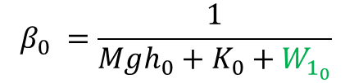
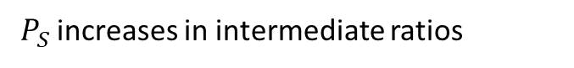
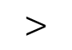
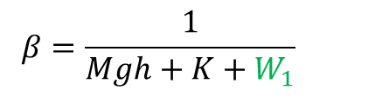
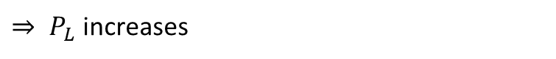
Results tendency: horizontal throw
Analysis of the new estimative of $β$
At the machine$:K+W_{hor_{1} } ≪At the horizontal throw:K+W_{hor_{2}}$
$$β_{0} =\frac{1}{Mgh_{0}+K_{0}+W_{1_{0}}}$$
$$β=\frac{1}{Mgh+K+W_{1}}$$
$$>$$
$P_{S}$ increases in intermediate ratios
Increase of $Mgh⇒$ Increase of $W_{1}$ in magnitude
Low friction $⇒$ $W_{1}$ has small increase
$⇒$ Denominator increases
$⇒ P_{L}$ increases
High friction $⇒W_{1}$ has big increase
$⇒$ Compensates or exceeds the increase of $Mgh$ untill a certain $h_{max}$
$⇒$Decrease of $P_{L}$ ultill maximum dissipation of K

Slide 18
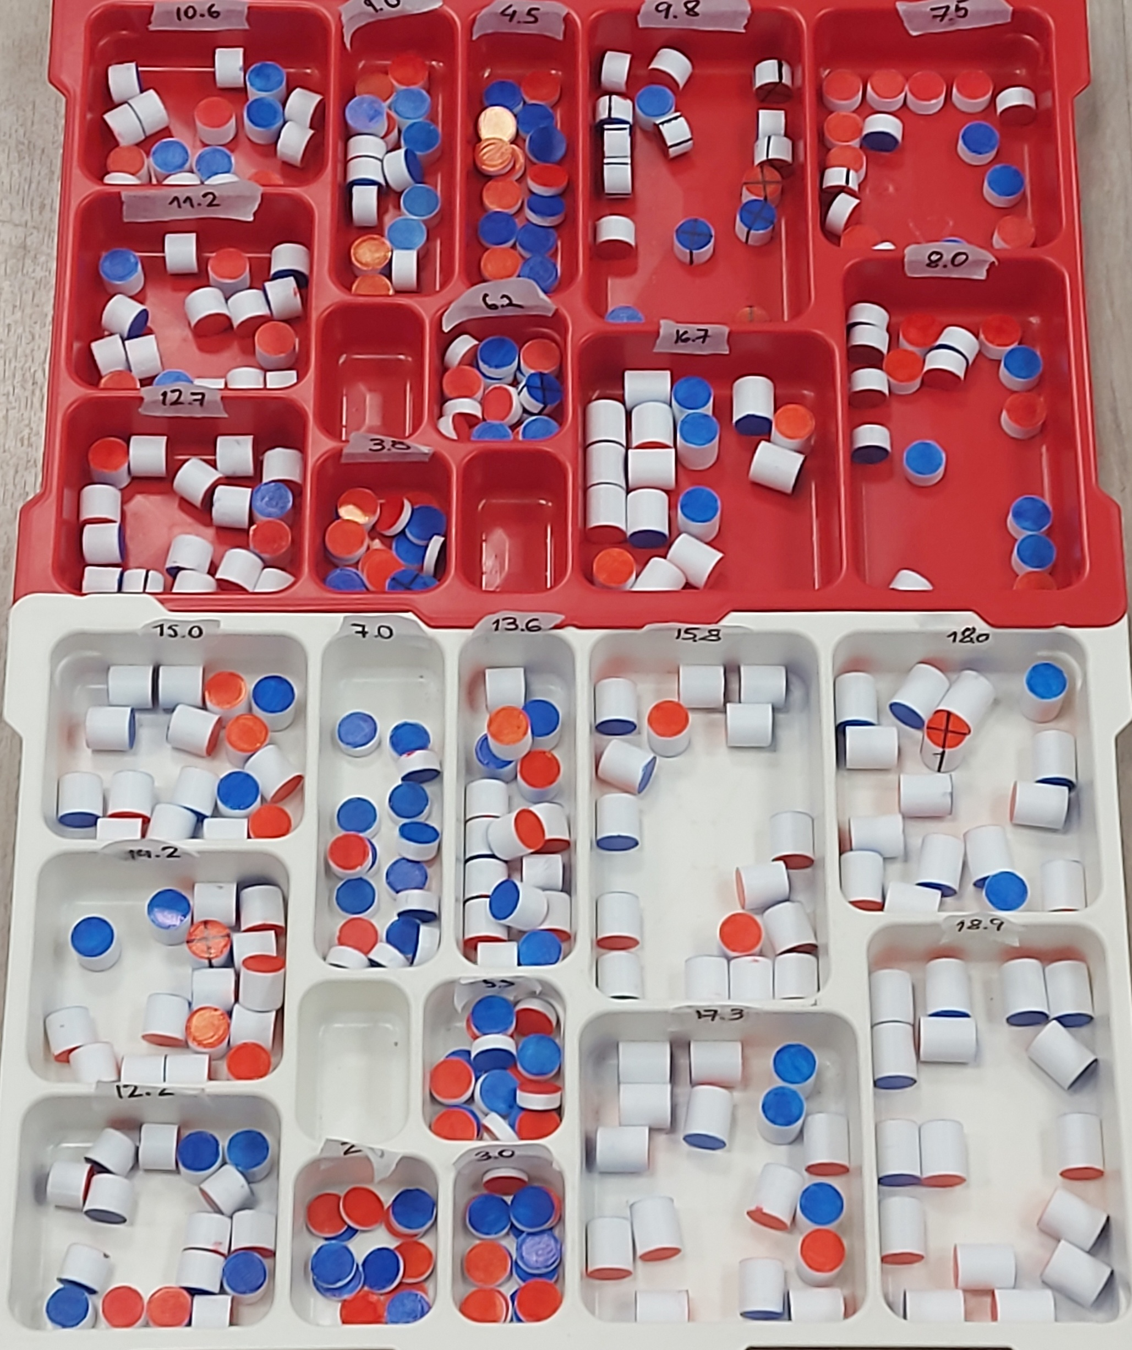
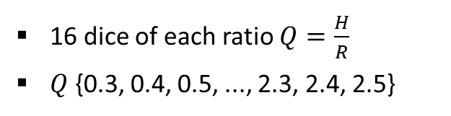
368 dice used
16 dice of each ratio $Q=\frac{H}{R}$
$Q$ {0.3, 0.4, 0.5, ..., 2.3, 2.4, 2.5}
3200 throws per ratio
4800 throws per hour

Slide 19





Data obtained and calculation of uncertainties
Results
Extreme ratios always have probabilities near to the limits, as expected
Intermediate raitios are more affected by changes in $β$;
Recognition erros can systematically influence the results
Results, in general, are in match with the theoretical expectations
Mean uncertainty
$Q$ uncertainty
$$\overline{y}=\frac{1}{200}\sum_{i=1}^{200}{y_{i}}$$
$$S_{Q}^{2}={\left(\frac{∂Q}{∂H}\right)}^{2}S_{H}^{2}+{\left(\frac{∂Q}{∂R}\right)}^{2}S_{R}^{2}$$
$$S_{\overline{y}}=\sqrt{\frac{1}{200(200−1)} \sum_{j=1}^{200}{{\left(y_{j}−\overline{y}\right)}^{2}}}$$
$$S_{Q}=\sqrt{\frac{1}{R^{2}}S_{H}^{2}+\frac{H^{2}}{R^{4}}S_{R}^{2}}$$

Slide 20



$$P_{S}$$
$$Q=H/R$$

Slide 21


$$P_{S}$$
Experimental fit $\left(β=\frac{463±21}{Mg}\right)$
$$Q=H/R$$

Slide 22


Residue analysis
$$Q=H/R$$
Higher-than-expected probabilities in intermediate ratios
Larger uncertainty bars at points further from the curve
“Side” state can be supported by other dice or walls of the box

Slide 24



$$P_{S}$$
Theoretical curve $\left(β=\frac{493±49}{Mg}\right)$
Experimental fit $\left(β=\frac{463±21}{Mg}\right)$
$$Q=H/R$$

Slide 25




$$P_{S}=1/3$$
$$P_{S}$$
$$Q=(1.400±0.017)$$
Experimental fit $\left(β=\frac{463±21}{Mg}\right)$
$$Q=H/R$$
25

Slide 26


Horizontal throw
Padronizarion of velocity

Slide 27


Sequence of collisions and rotations
Roll

Slide 28






PLA dice (used at the machine)
$$P_{S}\left(machine\right)=0.260±0.019$$
$$Q=1.3$$
$$P_{S}$$
$$Q=0.5$$
$$P_{S}\left(machine\right)=0.023±0.028$$
$$h(m)$$

Slide 29



PLA dice (used at the machine)
$$P_{S}\left(machine\right)=0.260±0.019$$
$$Q=1.3$$
$$P_{S}$$
$$\overline{P}=0.49±0.08$$
$$Q=0.5$$
$$P_{S}\left(machine\right)=0.023±0.028$$
$$\overline{P}=0.07±0.04$$
$$h(m)$$

Slide 30



PU dice (polyurethane) – $Q$ = $1,2$
$$h↑ ⇒P_{S}↓$$
$$P_{S}$$
$$h(m)$$

Slide 32


“Fair” dice existis only for specific situations
At the machine: “fair” ratio is near to $Q=1.4$
Changes of $β$ drastically affect the results, allowing manipulations
Extra:
With certain adaptations, the theory can be applied to other solid shapes
Applying this theory to conventional dice, it is possible to prove that they are fair regardless of changes in $β$
Changes in the distribution of mass could generate a biased dice

Slide 34






Cálculo dos momentos de inércia
$$I_{1}=I_{2}=I=\int{r² dm}=\int{r^{2} σ dV}=σ\int_{0}^{2π}{\int_{0}^{R}{\int_{−\frac{H}{2}}^{\frac{H}{2}}{\left(z^{2}+y^{2}\right) ρ dz dρ dθ}}}$$
$$\boxed{σ=\frac{M}{πR^{2}H}}$$
$$=σ\int_{0}^{2π}{\int_{0}^{R}{\int_{−\frac{H}{2}}^{\frac{H}{2}}{\left(z^{2}+ρ^{2}\sin^{2}{θ}\right) ρ dz dρ dθ}}}=σ\int_{0}^{2π}{\int_{0}^{R}{\left(\frac{\left(\frac{H^{3}}{4}\right)ρ}{3}+Hρ^{3}\sin^{2}{θ}\right) dρ dθ}}$$
$$=σ\int_{0}^{2π}{\left(\frac{H^{3}R²}{24}+\frac{HR^{4}\sin^{2}{θ}}{4}\right) dθ}=σ\left(\frac{πH^{3}R^{2}}{12}+\frac{πHR^{4}}{4}\right)=\frac{M}{πR^{2}H}\left(\frac{πH^{3}R^{2}}{12}+\frac{πHR^{4}}{4}\right)$$
$$\boxed{I=\frac{MH^{2}}{12}+\frac{MR^{2}}{4}}$$
$$I_{3}=\int{r² dm}=\int{r^{2} σ dV}=σ\int_{0}^{R}{ρ³ dρ}\int_{−\frac{H}{2}}^{\frac{H}{2}}{dz}\int_{0}^{2π}{dθ}=σ\frac{R^{4}}{4}2πH=\frac{MR^{4}2πH}{4πR^{2}H}$$
$$\boxed{I_{3}=\frac{MR^{2}}{2}}$$

Slide 35



Reescrevendo a energia mecânica com momentos canonicamente conjugados
$$L=\frac{MV^{2}}{2}+\frac{Iω_{1}^{2}}{2}+\frac{Iω_{2}^{2}}{2}+\frac{I_{3}ω_{3}^{2}}{2}−Mgh$$
Lagrangiana
$$\left\{\begin{aligned}p_{φ}=\frac{∂L}{∂\dot{φ}}=\left(I\sin^{2}{θ+I_{3}\cos^{2}{θ}}\right)\dot{φ}+I_{3}\cos{θ}\dot{ψ} \\ p_{ψ}=\frac{∂L}{∂\dot{ψ}}=I_{3}\left(\dot{φ}\cos{θ}+\dot{ψ}\right)=I_{3}ω_{3}\end{aligned}\right.$$
Momentos canonicamente
conjugados
(constantes do movimento livre)
$$\boxed{E=\frac{MV^{2}}{2}+\frac{I\dot{θ²}}{2}+\frac{{\left(p_{φ} −p_{ψ}\cos{θ}\right)}^{2}}{2I\sin{²θ}}+\frac{p_{ψ}²}{2I_{3}}+Mgh}$$
Energia mecânica

Slide 36


Cálculo da energia dissipada na primeira colisão
$$W_{1}= \int_{0}^{Δt_{1}}{\left(\vec{F}+ \vec{f}\right)∙\vec{V} dt} + \int_{0}^{Δt_{1}}{\vec{ω′}∙\vec{τ^{′}} dt}$$
(1)
(2)
(1)
$$\int_{0}^{Δt_{1}}{\left(\vec{F}+ \vec{f}\right)∙\vec{V} dt}=\int_{0}^{Δt_{1}}{\vec{F}∙\vec{V} dt}+\int_{0}^{Δt_{1}}{\vec{f}∙\vec{V} dt}$$
(1.1)
(1.2)
2ª Lei de Newton
$$\frac{d\vec{p}}{dt}= \vec{F}+\vec{f}+M\vec{g}⇒M\frac{d\vec{V}}{dt}=\vec{F}+\vec{f}+M\vec{g}$$
$$M\frac{d}{dt}\left(V_{ρ}\hat{ρ} +V_{n}\hat{n} +V_{3}{\hat{e}}_{3}^{′} \right)=F{\hat{e}}_{3}^{′}+f_{ρ}\hat{ρ}+f_{n}\hat{n}−Mg{\hat{e}}_{3}^{′}$$
$$M\left(\frac{dV_{ρ}}{dt}\hat{ρ}+V_{ρ}\frac{d\hat{ρ}}{dt}+\frac{dV_{n}}{dt}\hat{n}+V_{n}\frac{d\hat{n}}{dt}+\frac{dV_{3}}{dt}{\hat{e}}_{3}^{′}+V_{3}\frac{d{\hat{e}}_{3}^{′}}{dt}\right)=(F−Mg){\hat{e}}_{3}^{′}+f_{ρ}\hat{ρ}+f_{n}\hat{n}$$
0

Slide 37


Cálculo da energia dissipada na primeira colisão
$$M\left(\frac{dV_{ρ}}{dt}\hat{ρ}+V_{ρ}\dot{φ}\hat{n}+\frac{dV_{n}}{dt}\hat{n}+V_{n}\dot{φ}\hat{ρ}+\frac{dV_{3}}{dt}{\hat{e}}_{3}^{′}\right)=\left(F−Mg\right){\hat{e}}_{3}^{′}+f_{ρ}\hat{ρ}+f_{n}\hat{n}$$
$$F=M\frac{dV_{3}}{dt}+Mg$$
$$f_{ρ}=M\frac{dV_{ρ}}{dt}−{MV}_{n}\dot{φ}$$
Substituir em (1.1)
$$f_{n}=M\frac{dV_{n}}{dt}+{MV}_{ρ}\dot{φ}$$
$$\int_{0}^{Δt_{1}}{\vec{F}∙\vec{V} dt}=\int_{0}^{Δt_{1}}{F{\hat{e}}_{3}^{′}∙\left(V_{3}{\hat{e}}_{3}^{′}+V_{ρ}\hat{ρ}+V_{n}\hat{n}\right) dt}=\int_{0}^{Δt_{1}}{F V_{3} dt}$$
(1.1)
$$=\int_{0}^{Δt_{1}}{M\frac{dV_{3}}{dt}V_{3} dt}+\int_{0}^{Δt_{1}}{M g V_{3} dt}=\int_{0}^{Δt_{1}}{M\frac{d}{dt}\left(\frac{V_{3}^{2}}{2}\right) dt}+\int_{0}^{Δt_{1}}{M g\frac{dh}{dt}dt}$$
$$= \boxed{\frac{MV_{3,1}^{2}}{2}−\frac{MV_{3,0}^{2}}{2}+Mg\left(h_{1}−h_{0}\right)}$$

Slide 38



Cálculo da energia dissipada na primeira colisão
$$\int_{0}^{Δt_{1}}{\vec{f}∙\vec{V} dt}=\int_{0}^{Δt_{1}}{\left(f_{ρ}\hat{ρ}+f_{n}\hat{n}\right)\left(V_{3}{\hat{e}}_{3}^{′}+V_{ρ}\hat{ρ}+V_{n}\hat{n}\right) dt}=\int_{0}^{Δt_{1}}{\left(f_{ρ}V_{ρ}+f_{n}V_{n}\right)dt}$$
(1.2)
$$=\int_{0}^{Δt_{1}}{\left(M\frac{dV_{ρ}}{dt}V_{ρ}−MV_{n}V_{ρ}\dot{φ}+M\frac{dV_{n}}{dt}V_{n}+MV_{n}V_{ρ}\dot{φ}\right)dt}= \int_{0}^{Δt_{1}}{\frac{d}{dt}\left(\frac{MV_{ρ}^{2}}{2}\right)+\frac{d}{dt}\left(\frac{MV_{n}^{2}}{2}\right) dt}$$
$$= \frac{MV_{ρ,1}^{2}}{2}−\frac{MV_{ρ,0}^{2}}{2}+\frac{MV_{n,1}^{2}}{2}−\frac{MV_{n,0}^{2}}{2} = \boxed{\frac{MV_{h,1}^{2}}{2}−\frac{MV_{h,0}^{2}}{2}}$$
$$V_{h}^{2}=V_{ρ}^{2}+V_{n}^{2}$$
(2)
$$\int_{0}^{Δt_{1}}{\vec{ω′}∙\vec{τ^{′}} dt}=\int_{0}^{Δt_{1}}{\vec{ω}∙\vec{τ} dt}=\int_{0}^{Δt_{1}}{\left(ω_{1}τ_{1}+ω_{2}τ_{2}+ω_{3}τ_{3}\right)dt}$$
$$\left\{\begin{aligned}ω_{1}τ_{1}=I\dot{ω_{1}}ω_{1}−\left(I−I_{3}\right)ω_{2}ω_{3}ω_{1} \\ ω_{2}τ_{2}=I\dot{ω_{2}}ω_{2}−\left(I_{3}−I\right)ω_{3}ω_{1}ω_{2} \\ ω_{3}τ_{3}=I\dot{ω_{3}}ω_{3}−\left(I−I\right)ω_{1}ω_{2}ω_{3}\end{aligned}\right.$$
Equações de Euler $∗ω_{i}$
+
0

Slide 39

Cálculo da energia dissipada na primeira colisão
$$∴ ω_{1}τ_{1}+ω_{2}τ_{2}+ω_{3}τ_{3}=I\dot{ω_{1}}ω_{1}+I\dot{ω_{2}}ω_{2}+I_{3}\dot{ω_{3}}ω_{3}$$
$$⇒\int_{0}^{Δt_{1}}{\left(ω_{1}τ_{1}+ω_{2}τ_{2}+ω_{3}τ_{3}\right) dt}=\int_{0}^{Δt_{1}}{\left(I\dot{ω_{1}}ω_{1}+I\dot{ω_{2}}ω_{2}+I_{3}\dot{ω_{3}}ω_{3}\right) dt}$$
$$=\boxed{\frac{Iω_{1,1}^{2}}{2}+\frac{Iω_{2,1}^{2}}{2}+\frac{Iω_{3,1}^{2}}{2}−\frac{Iω_{1,1}^{2}}{2}−\frac{Iω_{2,1}^{2}}{2}−\frac{Iω_{3,1}^{2}}{2}}$$
$$W_{1}=\left(1.1\right)+\left(1.2\right)+\left(2\right)=\frac{MV_{3,1}^{2}}{2}−\frac{MV_{3,0}^{2}}{2}+Mg\left(h_{1}−h_{0}\right)+\frac{MV_{h,1}^{2}}{2}−\frac{MV_{h,0}^{2}}{2}$$
$$+\frac{Iω_{1,1}^{2}}{2}+\frac{Iω_{2,1}^{2}}{2}+\frac{Iω_{3,1}^{2}}{2}−\frac{Iω_{1,1}^{2}}{2}−\frac{Iω_{2,1}^{2}}{2}−\frac{Iω_{3,1}^{2}}{2}$$

Slide 40
Cálculo das probabilidades para N cilindros
$$P_{L}=\frac{1}{N}\sum_{n=0}^{N}{(n P_{n})}$$
$$n: quantidade de "lados"$$
$$P_{n}: probabilidade de se obter um estado com n "lados" e \left(N−n\right) "faces"$$
$$P_{n}=\frac{1}{Z}∙\frac{N!}{n!\left(N−n\right)!}∙C_{L}^{n}∙C_{F}^{(N−n)}∙e^{−βE_{n}}$$
$$E_{n}: energia associada a um estado com n "lados" e \left(N−n\right) "faces"$$
$$Z: função de partição$$
$$E_{n}=n∙U_{L}+\left(N−n\right)∙U_{F}$$
$$Z=\sum_{j=0}^{N}{\frac{N!}{j!\left(N−j\right)!}∙C_{L}^{j}∙C_{F}^{\left(N−j\right)}e^{−βE_{j}}}$$

Slide 41





Cálculo das probabilidades para N cilindros
$$P_{L}=\frac{1}{N}\sum_{n=0}^{N}{(n P_{n})}=\frac{1}{Z}\sum_{n=0}^{N}{\frac{n}{N}}∙\frac{N!}{n!\left(N−n\right)!}∙C_{L}^{n}∙C_{F}^{(N−n)}∙e^{−βE_{n}}$$
$$P_{L}=\frac{\sum_{n=0}^{N}{\frac{n}{N}∙\frac{N!}{n!\left(N−n\right)!}∙C_{L}^{n}∙C_{F}^{\left(N−n\right)}∙{{(e}^{−βU_{L}})}^{n}∙{{(e}^{−βU_{F}})}^{N−n}}}{\sum_{j=0}^{N}{\frac{N!}{j!\left(N−j\right)!}∙C_{L}^{j}∙C_{F}^{\left(N−j\right)}∙{\left(e^{−βU_{L}}\right)}^{j}∙{\left(e^{−βU_{F}}\right)}^{N−j}}}$$
$$\boxed{{\left(x+a\right)}^{n}=\sum_{k=0}^{n}{\left({n \atop k}\right)x^{k}a^{n−k}}}$$
$$P_{L}=\frac{\sum_{n=1}^{N}{\frac{\left(N−1\right)!}{\left(n−1\right)!\left(N−n\right)!}∙C_{L}^{n}∙C_{F}^{\left(N−n\right)}∙{{(e}^{−βU_{L}})}^{n}∙{{(e}^{−βU_{F}})}^{N−n}}}{{\left(C_{L}e^{−βU_{L}} +C_{F}e^{−βU_{F}}\right)}^{N}}$$
$$\boxed{n^{′}=n−1}$$
$$P_{L}=\frac{\sum_{n^{′}= 0}^{N−1}{\frac{\left(N−1\right)!}{\left(n^{′}\right)!\left(\left(N−1\right)−n^{′})\right)!}∙C_{L}^{n^{′}+1}∙C_{F}^{\left(N−1−n^{′}\right)}∙{{(e}^{−βU_{L}})}^{n^{′}+1}∙{{(e}^{−βU_{F}})}^{N−1−n^{′}}}}{{\left(C_{L}e^{−βU_{L}} +C_{F}e^{−βU_{F}}\right)}^{N}}$$
$$P_{L}=\frac{C_{L}e^{−βU_{L}}{\left(C_{L}e^{−βU_{L}}+C_{F}e^{−βU_{F}}\right)}^{N−1}}{{\left(C_{L}e^{−βU_{L}} +C_{F}e^{−βU_{F}}\right)}^{N}}⇒\boxed{P_{L}=\frac{C_{L}e^{−βU_{L}}}{C_{L}e^{−βU_{L}} +C_{F}e^{−βU_{F}}}}$$

Slide 42



Áreas da esfera circunscrita
$$A_{F}=\int_{0}^{2π}{dφ}\int_{0}^{θ_{L}}{r²\sin{θ}dθ}=2πr^{2}\left(−cos{θ_{L}}+\cos{0}\right)=2πR^{2}\left(1+\frac{Q^{2}}{4}\right)\left(1−\cos{\operatorname{atan}\left(\frac{2}{Q}\right)}\right)$$
$$\boxed{A_{F}=2πR^{2}\left(1+\frac{Q^{2}}{4}\right)\left(1−\frac{Q}{\sqrt{Q^{2}+4}}\right)}$$
$$\boxed{\cos{(\operatorname{atan}{x})}=\frac{1}{\sqrt{1+x^{2}}}}$$
$$A_{L}=4πr^{2}−2\left(2πr^{2}\left(1−\cos{θ_{L}}\right)\right)=4πr^{2}\cos{θ_{L}}=4πR^{2}\left(1+\frac{Q^{2}}{4}\right)\left(\cos{\operatorname{atan}\left(\frac{2}{Q}\right)}\right)$$
$$\boxed{A_{L}=4πR^{2}\left(1+\frac{Q^{2}}{4}\right)\left(\frac{Q}{\sqrt{Q^{2}+4}}\right)}$$

Slide 43





Estimativa de $β$
$$β=\frac{N}{\int_{0}^{h}{{\vec{F}}_{vert}∙d\vec{r}}+\int_{0}^{ΔS_{hor}}{{\vec{F}}_{hor}∙d\vec{r}}}$$
(1)
(2)
$$\int_{0}^{h}{{\vec{F}}_{vert}∙d\vec{r}}=\frac{Mv_{0_{vert}}^{2}}{2}=Mgh⇒v_{0_{vert}}^{2}=2gh$$
(1)
$$\boxed{β=\frac{N}{Mg\left(h+\frac{ΔS_{hor}^{2}}{16h}\right)}}$$
$$\int_{0}^{ΔS_{hor}}{{\vec{F}}_{hor}∙d\vec{r}}=\frac{Mv_{0_{hor}}^{2}}{2}$$
(2)
$$h=\sqrt{2gh} t−\frac{gt^{2}}{2}⇒t=\frac{\sqrt{2gh}±\sqrt{2gh−\frac{4gh}{2}}}{g}⇒t=\sqrt{\frac{2h}{g}}$$
$$v_{0_{hor}}^{2}=\frac{ΔS_{hor}^{2}}{4t^{2}}=\frac{g}{8h}∙ΔS_{hor}^{2}⇒\int_{0}^{ΔS_{hor}}{{\vec{F}}_{hor}∙d\vec{r}}=\frac{MgΔS_{hor}^{2}}{16h}$$

Slide 44


Incerteza de $Q$
$$S_{Q}^{2}={\left(\frac{∂Q}{∂H}\right)}^{2}S_{H}^{2}+{\left(\frac{∂Q}{∂R}\right)}^{2}S_{R}^{2}=\frac{1}{R^{2}}S_{H}^{2}+\frac{H^{2}}{R^{4}}S_{R}^{2}⇒S_{Q}=\sqrt{\frac{1}{R^{2}}S²+\frac{H^{2}}{R^{4}}S²}=\frac{S}{R}\sqrt{1+Q^{2}}$$
$$\boxed{S_{H}=S_{R}=S}$$

Slide 45






Aplicação a um dado cúbico
$$P_{F_{1}}=\frac{1}{Z}C_{F_{1}}e^{−βU_{F_{1}}}$$
$$P_{F_{2}}=\frac{1}{Z}C_{F_{2}}e^{−βU_{F_{2}}}$$
$$⋮$$
$$P_{F_{6}}=\frac{1}{Z}C_{F_{6}}e^{−βU_{F_{6}}}$$
$$U_{F_{1}}=U_{F_{2}}=…=U_{F_{6}}=U_{F}$$
$$Z=6∙C_{F}e^{−βU_{F}}$$
$$C_{F_{1}}=C_{F_{2}}=…=C_{F_{6}}=C_{F}$$
$$P_{F_{n}}=\frac{C_{F}e^{−βU_{F}}}{6∙C_{F}e^{−βU_{F}}}=\frac{1}{6}$$
$$\boxed{P_{F}=\frac{1}{6}}$$

Slide 46










Estimating β
$$pV=NkT⇒\int_{0}^{ΔS}{\vec{F}∙d\vec{r}}=NkT⇒\frac{1}{kT}=\frac{N}{\int_{0}^{ΔS}{\vec{F}∙d\vec{r}}}$$
$$\vec{F^{′}}$$
$$β=\frac{1}{kT}=\frac{N}{\int_{0}^{h}{{\vec{F}}_{vert}∙d\vec{r}}+\int_{0}^{ΔS_{hor}}{{\vec{F}}_{hor}∙d\vec{r}}}$$
Similarly:
Work-Energy Theorem
$${\vec{F}}_{vert}$$
$$\int_{0}^{h}{{\vec{F}}_{vert}∙d\vec{r}}=Mgh$$
$$\int_{0}^{ΔS_{hor}}{{\vec{F}}_{hor}∙d\vec{r}}=\frac{Mv_{0_{hor}}^{2}}{2}$$
$${\vec{F^{′}}}_{hor}$$
$${\vec{F}}_{hor}$$
$$\boxed{β=\frac{N}{Mg\left(h +\frac{v_{0_{hor}}^{2}}{2g}\right)}}$$
$${\vec{F^{′}}}_{vert}$$

